Slide 1
Artificial Vision System for Meat Quality Gradation
B. Tech Major Project Report
By :
Debdoot Roy Chowdhury (GCECTB-R19-3014)
Arunima Chaudhuri (GCECTB-R19-3008)
Shubhodeep Chanda (GCECTB-R19-3026)
Bidesh Banerjee (GCECTB-R19-3013)
Under the Supervision of :
Kingshuk Chatterjee

Slide 2
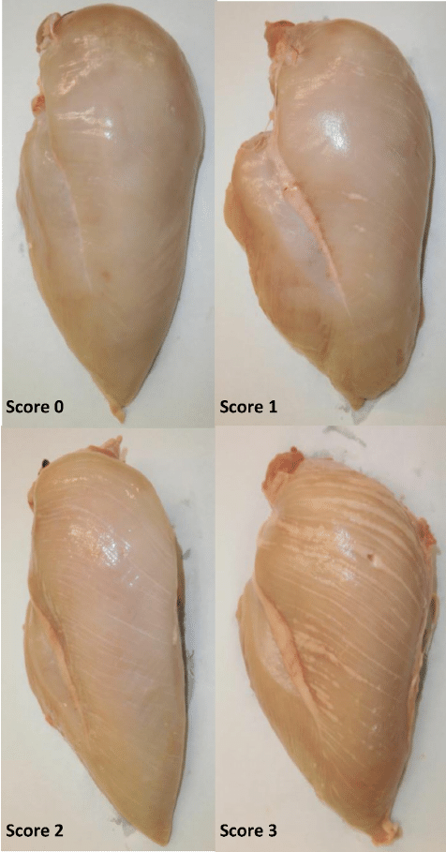
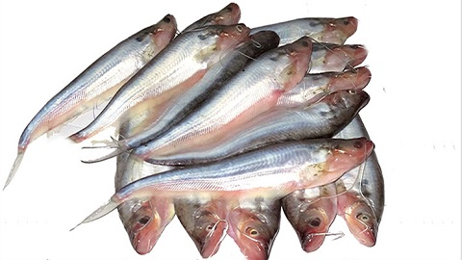
Problem statement
A rapid system for meat quality assessment is needed to guarantee the quality of meat.
We plan to solve this problem by developing a mobile application to help users determine meat freshness in real-time.

Slide 3
Importance of work
In today's world, food spoilage is a crucial problem as consuming spoiled food is harmful for consumers.
Meat is a kind of perishable food that easily decays.
As the number of meat consumers increases in the meat industry, the demand for meat supplies also rises. Determining meat freshness, therefore, is the primary consideration of the meat customers.
Due to covid, many people are ordering food items online. This has increased the necessity for real-time meat quality assessment through images.
It will be helpful for customers who don’t know how to check meat quality by seeing or touching it.

Slide 4
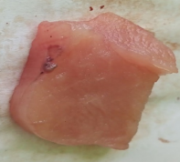
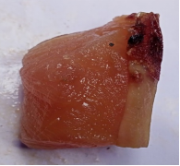
Dataset Preparation
1. Chicken
Breast meat portion was used as a sample for the dataset. The chicken breast was cut to various lengths and widths but with almost uniform thickness
The chicken meat images were captured starting from day 1 and at every 2 days' interval till 13th day. Chicken was stored in a freezer in the intermediate days with a temperature of 0 degree Celsius.
Meat images classified as consumable were taken till 5-6 days from day one of death, and meat classified as non-consumable were taken from 5-6 days of death till the 13th day.
Dataset Size -
1) Consumable - 188
2) Non Consumable - 122
Consumable
Non-Consumable

Slide 5
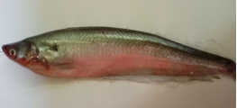
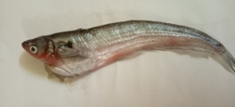
Dataset Preparation
2. Fish
The live Fish (Pabda) were sampled live from market.
The fish images were captured starting from day one of death and at every two days' interval till the 10th day. Fish was stored in a freezer in the intermediate days with a temperature of 0 degree Celsius.
Fish images classified as consumable were taken till 4-5 days from day one of death, and fish classified as non-consumable were taken from 5-6 days of death till the 10th day.
Dataset Size -
1) Consumable - 60
2) Non Consumable - 80
Consumable
Non-Consumable

Slide 6
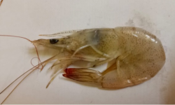
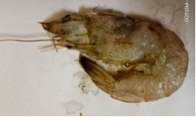
Dataset Preparation
3. Prawn
Fresh white-leg prawn were sampled live from market.
The prawn images were captured starting from day one of purchase and at every one day interval till 7th day. It was stored in a freezer in the intermediate days with a temperature of 0 degree Celsius.
Images classified as consumable were taken till 3-4 days from the day one of death, and images classified as non-consumable were taken from 3-4 days of death till the 7th day.
Dataset Size -
1) Consumable - 52
2) Non Consumable - 70
Consumable
Non-Consumable

Slide 7
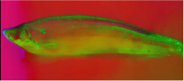
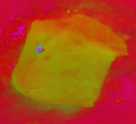
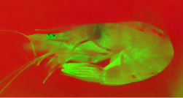
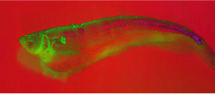
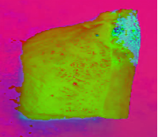
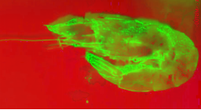
Methodology
1. Color Spaces
The image captured is in RGB color space then converted to HSV color space.
The use of HSV rather than RGB space is beneficial in texture analysis. Paschos [7] demonstrates that perceptually uniform spaces, such as HSV, outperform non-uniform RGB.
Consumable (HSV)
Consumable (HSV)
Consumable (HSV)
Non - Consumable (HSV)
Non - Consumable (HSV)
Non - Consumable (HSV)

Slide 8
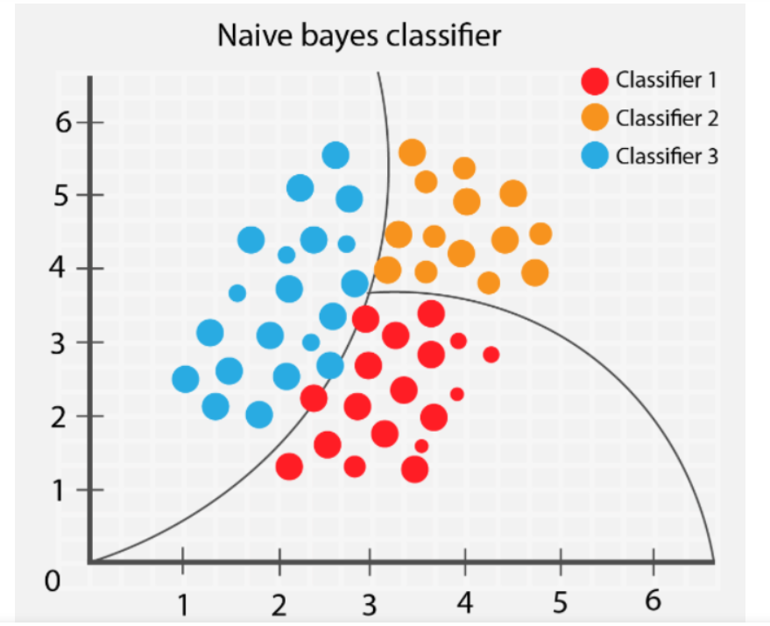
Methodology
2. Machine Learning Methods
a) Naive Bayes

Slide 9
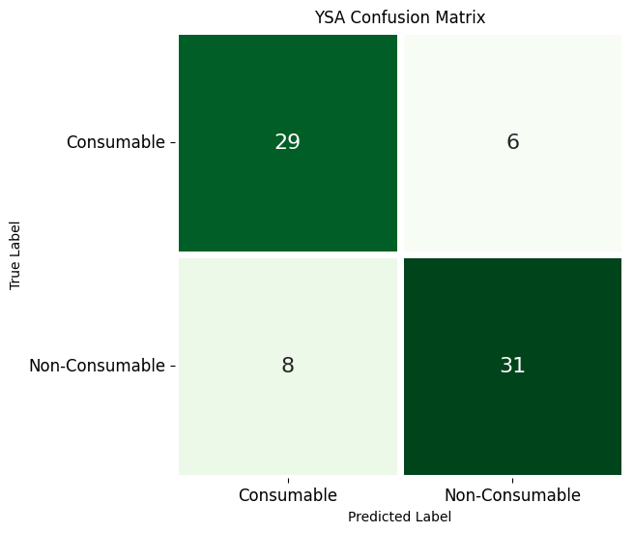
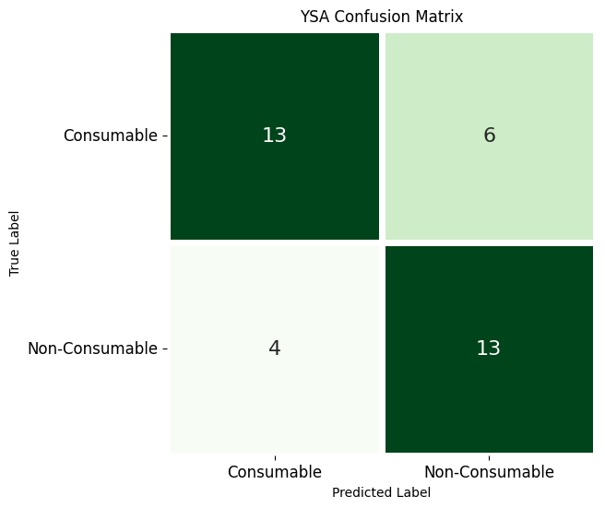
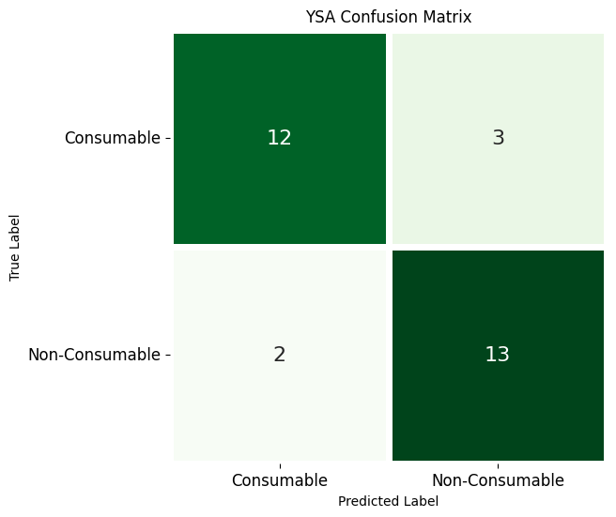
Methodology
Chicken Dataset (HSV)
Fish Dataset (HSV)
Prawn Dataset (HSV)

Slide 10
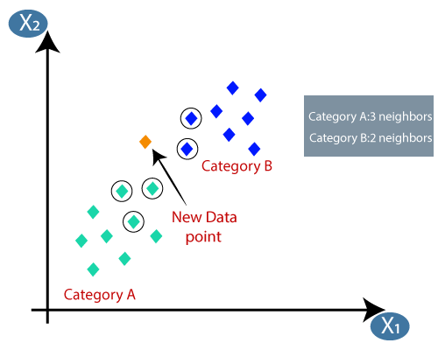
Methodology
2. Machine Learning Methods
b) K-Nearest-Neighbours (KNN)

Slide 11
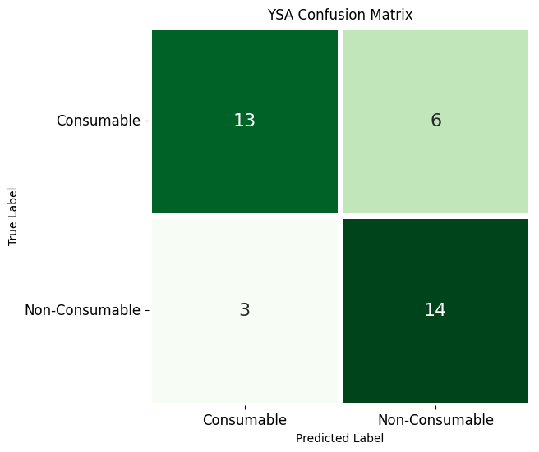

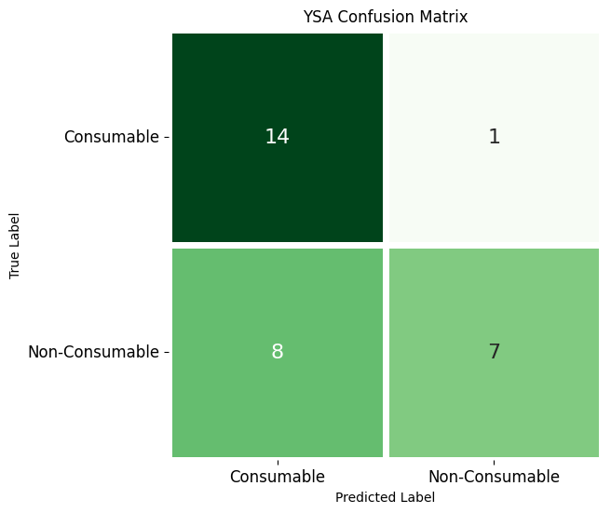
Methodology
Fish Dataset (HSV)
Prawn Dataset (HSV)
Chicken Dataset (HSV)

Slide 12

Methodology
2. Machine Learning Methods
c) Support Vector Machine (SVM)

Slide 13
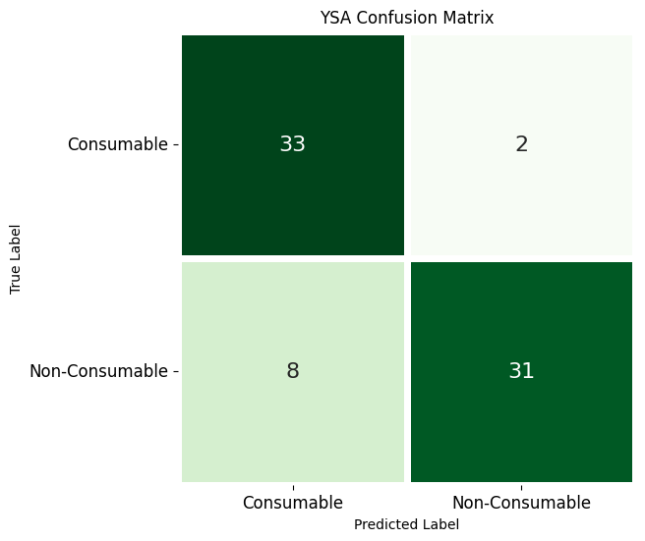
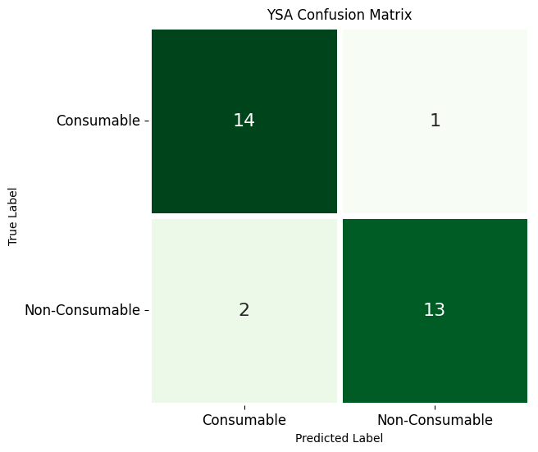
Methodology
Chicken Dataset (HSV)
Fish Dataset (HSV)
Prawn Dataset (HSV)

Slide 14
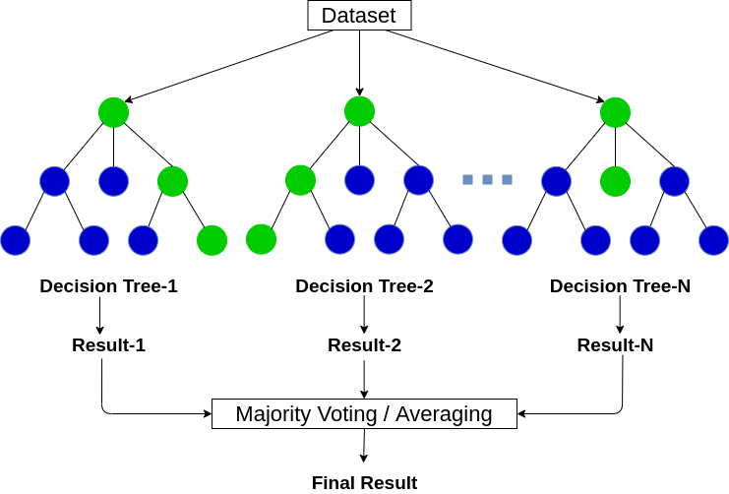
Methodology
2. Machine Learning Methods
d) Random forest

Slide 15
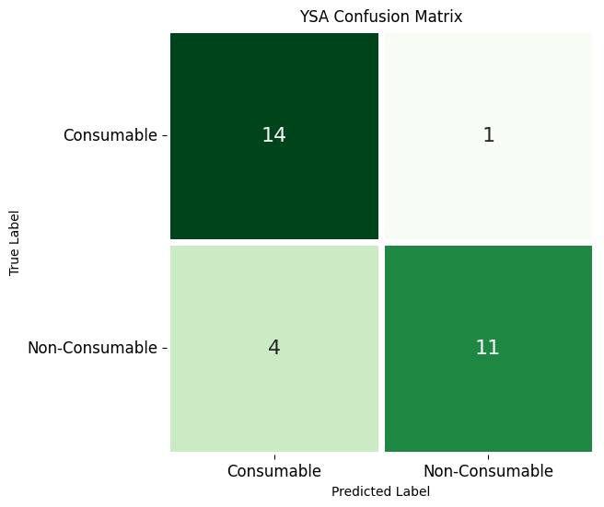
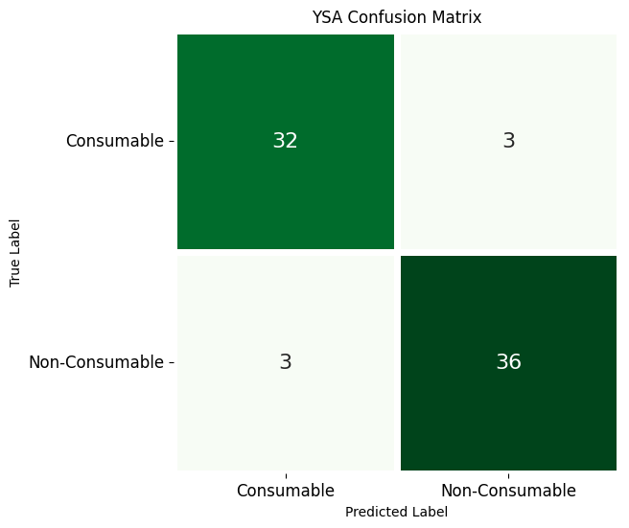
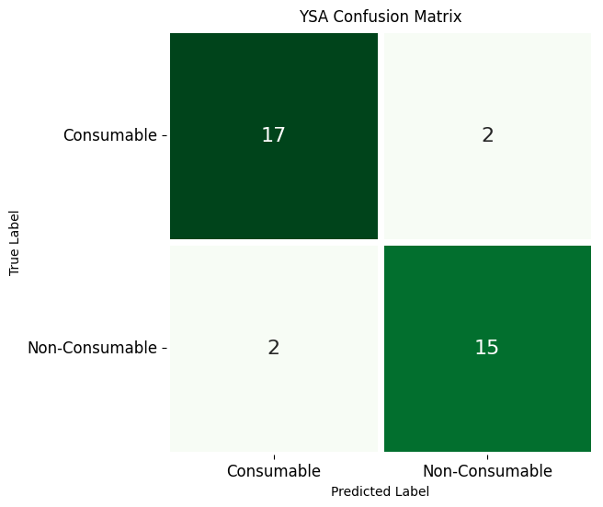
Methodology
Chicken Dataset (HSV)
Fish Dataset (HSV)
Prawn Dataset (HSV)

Slide 16
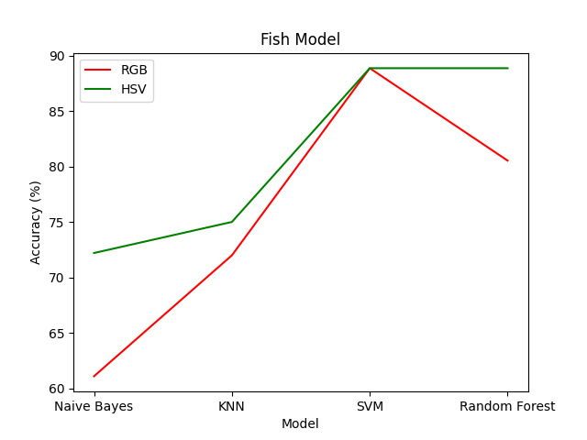
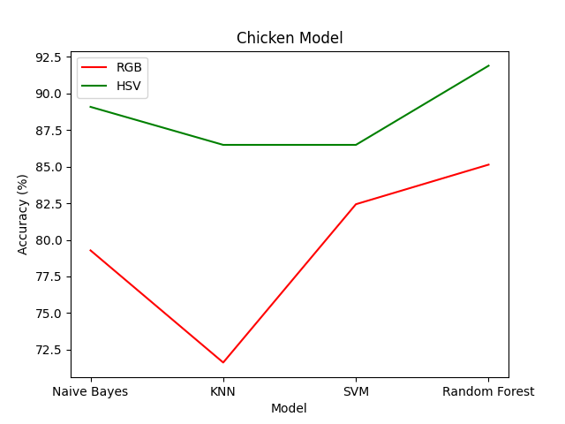
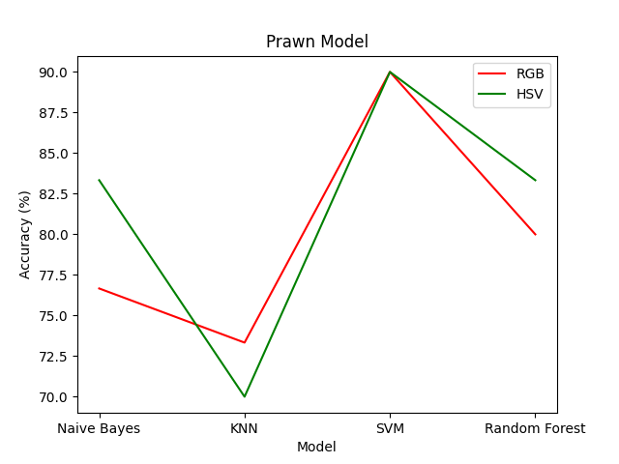
Summary
Machine Learning Model’s Summary

Slide 17
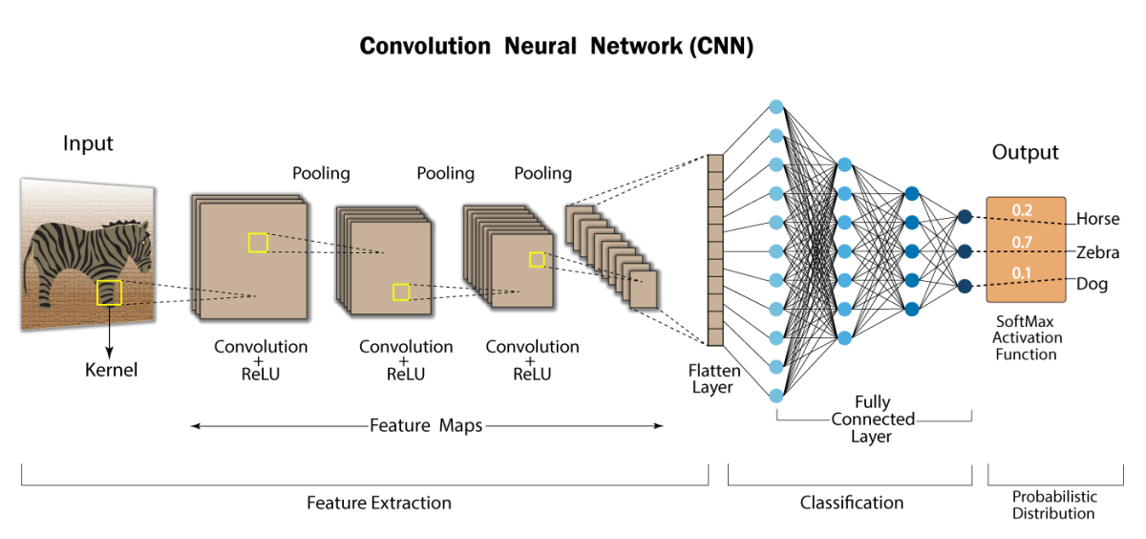
Methodology
3. Deep Learning Methods
a) Convolutional Neural Network

Slide 18
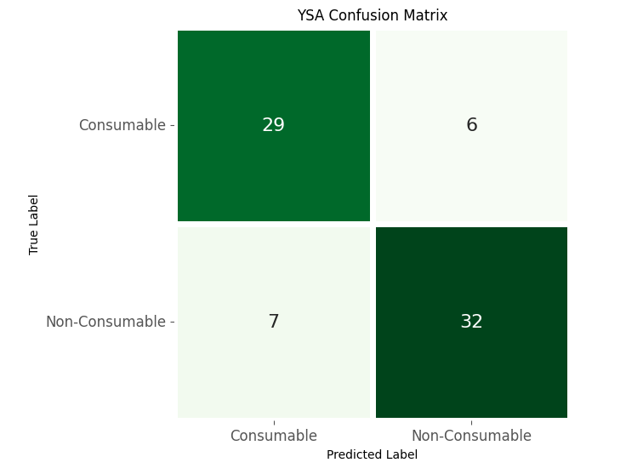
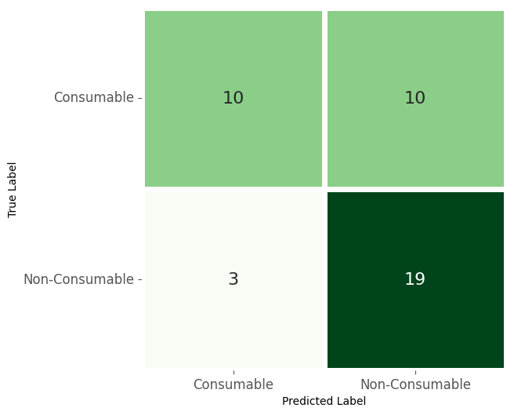

Methodology
Chicken Dataset (HSV)
Fish Dataset (HSV)
Prawn Dataset (HSV)

Slide 19
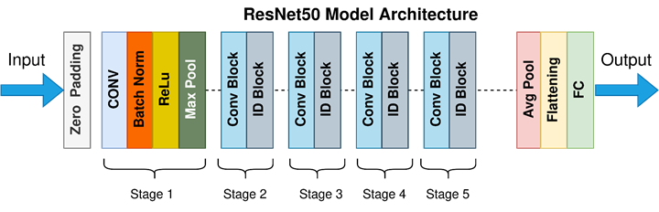
Methodology
3. Deep Learning Methods
b) Residual neural network (ResNet)

Slide 20



Methodology
Chicken Dataset (HSV)
Fish Dataset (HSV)
Prawn Dataset (HSV)

Slide 21
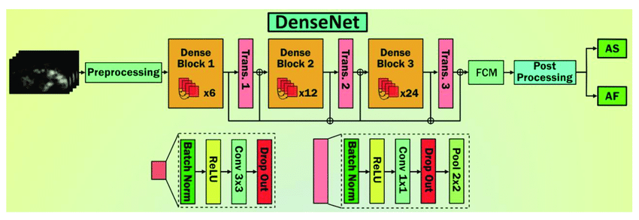
Methodology
3. Deep Learning Methods
c) Densely-connected-convolutional networks (DenseNet)

Slide 22

Methodology
Chicken Dataset (HSV)
Fish Dataset (HSV)
Prawn Dataset (HSV)

Slide 23
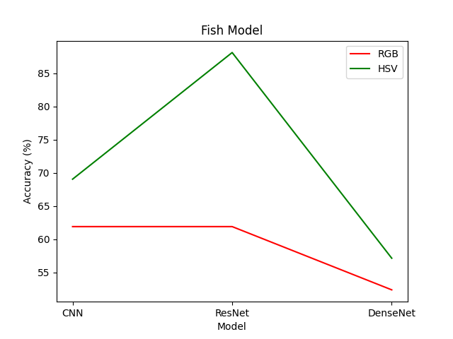
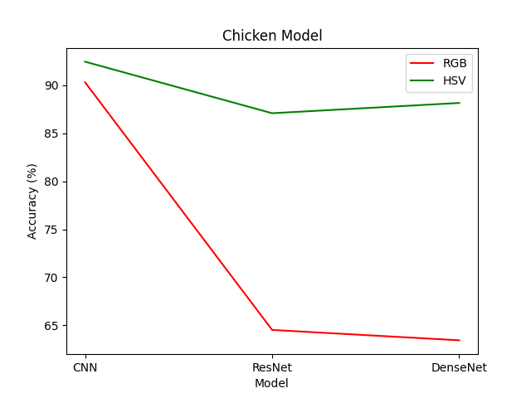
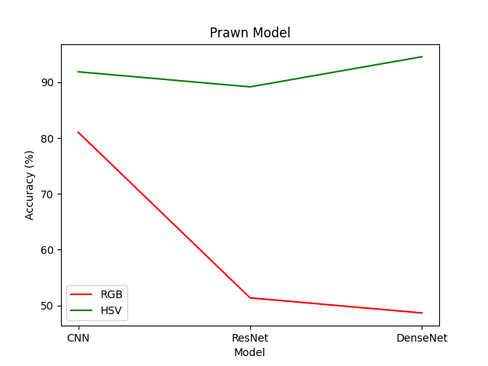
Summary
Deep Learning Model’s Summary

Slide 24
App Development
A mobile application using Flutter framework is developed to implement the idea of the above research.
It integrates a converted TensorFlow Lite (TFLite) model of the CNN model we designed earlier using the Keras interface of the TensorFlow framework.
The application allows the user to input an image through either the gallery or camera functionality.
Once the image is input, the TFLite model is used to predict the type of meat and its consumability.
Additionally, the application provides a remarks section based on the percentage of consumability predicted by the model.
The application is not only easy to use but also designed to work both online and offline, making it convenient for users who may have limited access to the internet.

Slide 25
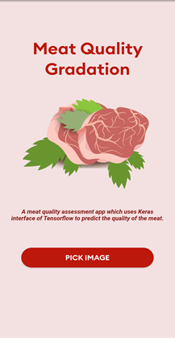
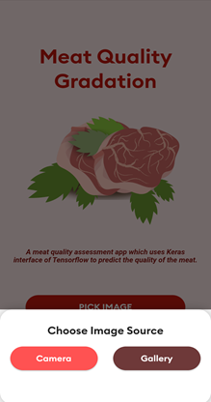
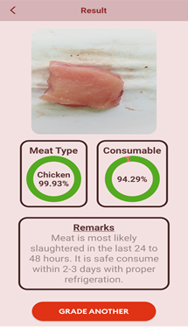
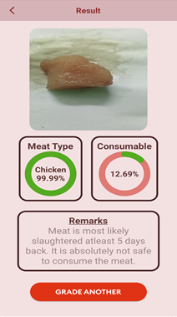
App Interface

Slide 26
App Interface
App Video Will Be Here

Slide 27
Conclusion
We observed for all the datasets Machine Learning as well as Deep Learning models gave better accuracy in HSV color space than RGB color space.
Machine Learning models like Random Forest gave the best accuracy of 90% in Chicken Dataset. Whereas, Deep Learning models like CNN gave best accuracy of over 92% in the same dataset.
On average, deep learning models like CNN and DesNet used for the above problem provided better accuracy than the machine learning models.
It is important to note that deep learning models are particularly effective for image-related tasks, such as object recognition and classification, due to their ability to automatically learn complex features and patterns from large datasets.
The images used in this study were captured on a white background. However, it is possible that the results could differ if images were taken on a colored background instead.
To conclude, artificial vision and deep learning is a reliable technique, and it has shown its efficiency in many applications related to meat assessment.

Slide 28
Future Work
Exploration of more complex deep learning models which are commonly used for image classification and can be efficiently incorporated into low-end devices such as mobile phones or Raspberry Pi's.
Improvement of the model which predicts the type of meat. While this model is effective in most cases, it is not always accurate as per our tests.
Making the app connected to the cloud and incorporate reinforcement learning into the app, which would allow the model to rectify it’s output and improve the learning model based on user feedback. This approach would enable the app to continuously improve its accuracy and better meet the needs of its users.
Incorporate additional features such as nutritional information and recipe suggestions based on the type and quality of the meat.

Slide 29
References
[1] Wijaya, Dedy Rahman, Riyanarto Sarno, and Enny Zulaika. "Noise filtering framework for electronic nose signals: An application for beef quality monitoring." Computers and Electronics in Agriculture 157 (2019): 305-321.
[2] Falasconi M, Concina I, Gobbi E, Sberveglieri V, Pulvirenti A, Sberveglieri. G.Electronic Nose for Microbiological Quality Control of Food Products. 2012; 2012.
[3] Makanan BPO. Graph of national poisoning case. , Jakarta (2016).
[4] Patra, Debasmita, et al. "Evaluation of global research trends in the area of food waste due to date labeling using a scientometrics approach." Food Control 115 (2020): 107307.
[5] Trientin, Danika, Bambang Hidayat, and Sjafril Darana. "Beef freshness classification by using color analysis, multi-wavelet transformation, and artificial neural network." 2015 International Conference on Automation, Cognitive Science, Optics, Micro Electro-Mechanical System, and Information Technology (ICACOMIT). IEEE, 2015.
[6] Taheri-Garavand, Amin, et al. "Real-time nondestructive monitoring of Common Carp Fish freshness using robust vision-based intelligent modeling approaches." Computers and Electronics in Agriculture 159 (2019): 16-27.
[7] Agustin, S., and R. Dijaya. "Beef image classification using K-nearest neighbor algorithm for identification quality and freshness." Journal of Physics: Conference Series. Vol. 1179. No. 1. IOP Publishing, 2019.
[8] Lumogdang, Christell Faith D., et al. "Supervised Machine Learning Approach for Pork Meat Freshness Identification." Proceedings of the 2019 6th International Conference on Bioinformatics Research and Applications. 2019.
[9] Lugatiman, Kenan, et al. "Tuna meat freshness classification through computer vision." 2019 IEEE 11th International Conference on Humanoid, Nanotechnology, Information Technology, Communication and Control, Environment, and Management (HNICEM). IEEE, 2019.

Slide 30
References
[10] Sun, Xin, et al. "Predicting pork color scores using computer vision and support vector machine technology." Meat and Muscle Biology 2.1 (2018).
[11] Hebbar, Nachiketa. "Freshness of food detection using IoT and machine learning." 2020 International Conference on Emerging Trends in Information Technology and Engineering (icETITE). IEEE, 2020.
[12] Guan, Xiao, et al. "Assessing the freshness of meat by using quantum-behaved particle swarm optimization and support vector machine." Journal of food protection 76.11 (2013): 1916-1922.
[13] Arsalane, Assia, et al. "An embedded system based on DSP platform and PCA-SVM algorithms for rapid beef meat freshness prediction and identification." Computers and Electronics in Agriculture 152 (2018): 385-392.
[14] Taheri-Garavand, Amin, et al. "Real-time nondestructive monitoring of Common Carp Fish freshness using robust vision-based intelligent modeling approaches." Computers and Electronics in Agriculture 159 (2019): 16-27.
[15] Dutta, Malay Kishore, et al. "Image processing based method to assess fish quality and freshness." Journal of Food Engineering 177 (2016): 50-58.
[16] Winiarti, Sri, Ahmad Azhari, and Khalidia Mega Agusta. "Determining feasibility level of beef quality based on histogram and k-means clustering." 2018 International Symposium on Advanced Intelligent Informatics (SAIN). IEEE, 2018.
[17] Chernov, Vladimir, Jarmo Alander, and Vladimir Bochko. "Integer-based accurate conversion between RGB and HSV color spaces." Computers & Electrical Engineering 46 (2015): 328-337.

Slide 31
References
[18] Wijaya, Dedy Rahman, Riyanarto Sarno, and Aldhiaz Fathra Daiva. "Electronic nose for classifying beef and pork using Naïve Bayes." 2017 International Seminar on Sensors, Instrumentation, Measurement and Metrology (ISSIMM). IEEE, 2017.
[19] Adi, Kusworo, et al. "Beef quality identification using color analysis and k-nearest neighbor classification." 2015 4th International Conference on Instrumentation, Communications, Information Technology, and Biomedical Engineering (ICICI-BME). IEEE, 2015.
[20] Cortez, Paulo, et al. "Lamb meat quality assessment by support vector machines." Neural Processing Letters 24 (2006): 41-51.
[21] Hanif, Salman, Dedy Rahman Wijaya, and Pramuko Aji. "Random Forest Algorithm for Meat Classification and Microbial Population Prediction." 2022 5th International Conference on Information and Communications Technology (ICOIACT). IEEE, 2022.
[22] Tan, Wei Keong, Zulkifli Husin, and Muhammad Amir Hakim Ismail. "Feasibility study of beef quality assessment using computer vision and Deep Neural Network (DNN) algorithm." 2020 8th International Conference on Information Technology and Multimedia (ICIMU). IEEE, 2020.
[23] Arora, Monika, and Parthasarathi Mangipudi. "A computer vision-based method for classification of red meat quality after nitrosamine appendage." International Journal of Computational Intelligence and Applications 20.01 (2021): 2150005.
[24] Lu, Tao, et al. "A generic intelligent tomato classification system for practical applications using DenseNet-201 with transfer learning." Scientific Reports 11.1 (2021): 1-8.

